Slide 1
Welcome and introduction to the GLOBE consensus
23 January 2021
Virtual Conference
9:10 to 17:45
Materials and value chains for sustainable, inclusive, and resilient urbanisation in Africa

Slide 2
The “GLOBE consensus”
What is it about?
23 January 2021
Virtual Conference
9:10 to 17:45
Materials and value chains for sustainable, inclusive, and resilient urbanisation in Africa

Slide 3
Global Consensus on Sustainability in the Built Environment
Objective
direct the attention of the global community, politicians, industry
leaders, and societal decision-makers to the critical importance of the
built environment for sustainable development at global and local scales
actions by all parties addressed are urgently required to ensure
that the built environment of the future is resilient, adequately safe, and socially, environmentally and economically sustainable
23 January 2021
Virtual Conference
9:10 to 17:45
Materials and value chains for sustainable, inclusive, and resilient urbanisation in Africa

Slide 4
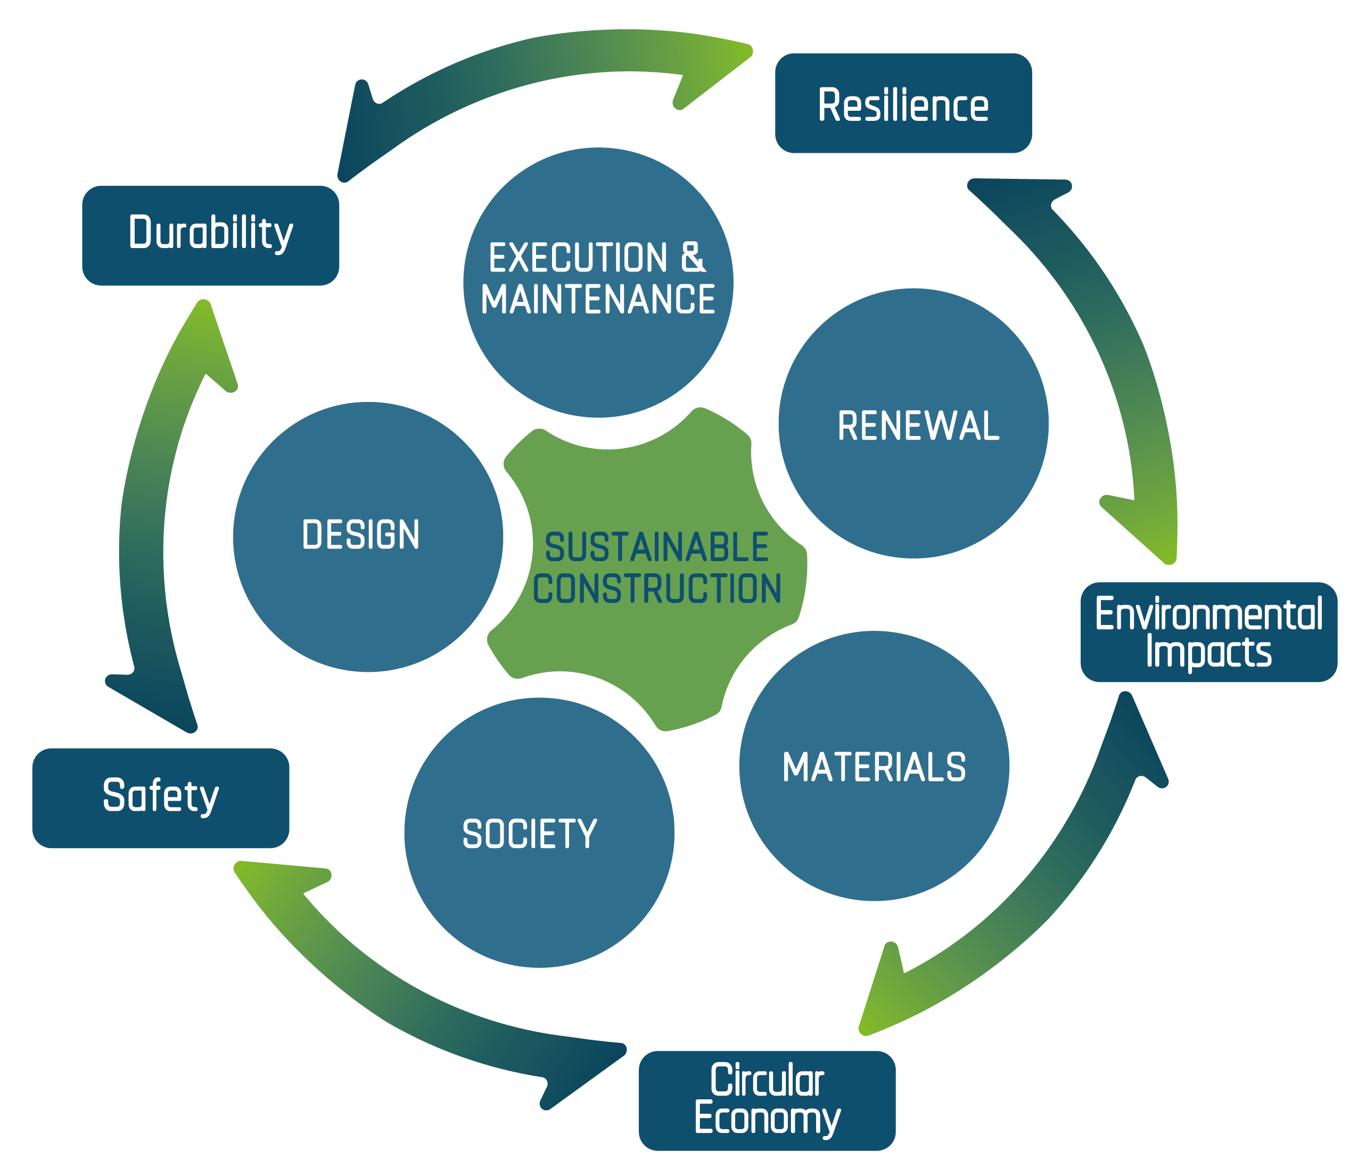
Global Consensus on Sustainability in the Built Environment
Objective

Slide 5
Global Consensus on Sustainability in the Built Environment
What is it about?
a paradigm shift within the entire built environment
give aspects of sustainability
the same value as aspects of structural integrity and durability
23 January 2021
Virtual Conference
9:10 to 17:45
Materials and value chains for sustainable, inclusive, and resilient urbanisation in Africa

Slide 6
Global Consensus on Sustainability in the Built Environment
A paradigm shift ?
Strength, durability, and service life requirements for construction materials and structural components should be specified on the basis of minimized environmental impact, life cycle analysis and optimization, and issues of technical obsolescence and efficiency in re-use and recycling. Quid need for methods, tools, financial incentives and regulations to implement circular economic strategies for design, construction, monitoring, maintenance, and renewal of the built environment
Develop new construction materials with lower environmental impact, and reassess known (but currently under-employed) construction materials
23 January 2021
Virtual Conference
9:10 to 17:45
Materials and value chains for sustainable, inclusive, and resilient urbanisation in Africa

Slide 7
Global Consensus on Sustainability in the Built Environment
Impact
100%
Global CO₂ equivalent emissions/year
Emissions from the construction sector alone can jeopardize the achievement of the objectives of the Paris agreement
50%
- Operation and maintenance of buildings represents
30%
20%
- Construction sector related (other construction materials,
transport, & construction processes)
10-15%
5-10%
- Production of cement,
0%
23 January 2021
Virtual Conference
9:10 to 17:45
Materials and value chains for sustainable, inclusive, and resilient urbanisation in Africa
Notes:
The construction sector is currently responsible for more than 20% of global annual CO₂ equivalent emissions. Between a quarter and half of these emissions are due to the production of cement, while the rest result from the manufacture of other construction materials, transport, and construction processes. Ongoing operation and maintenance of buildings represents almost an additional 30% of global CO₂ equivalent emissions.

Slide 8
The “GLOBE consensus”
Who is supporting this initiative?
23 January 2021
Virtual Conference
9:10 to 17:45
Materials and value chains for sustainable, inclusive, and resilient urbanisation in Africa

Slide 9
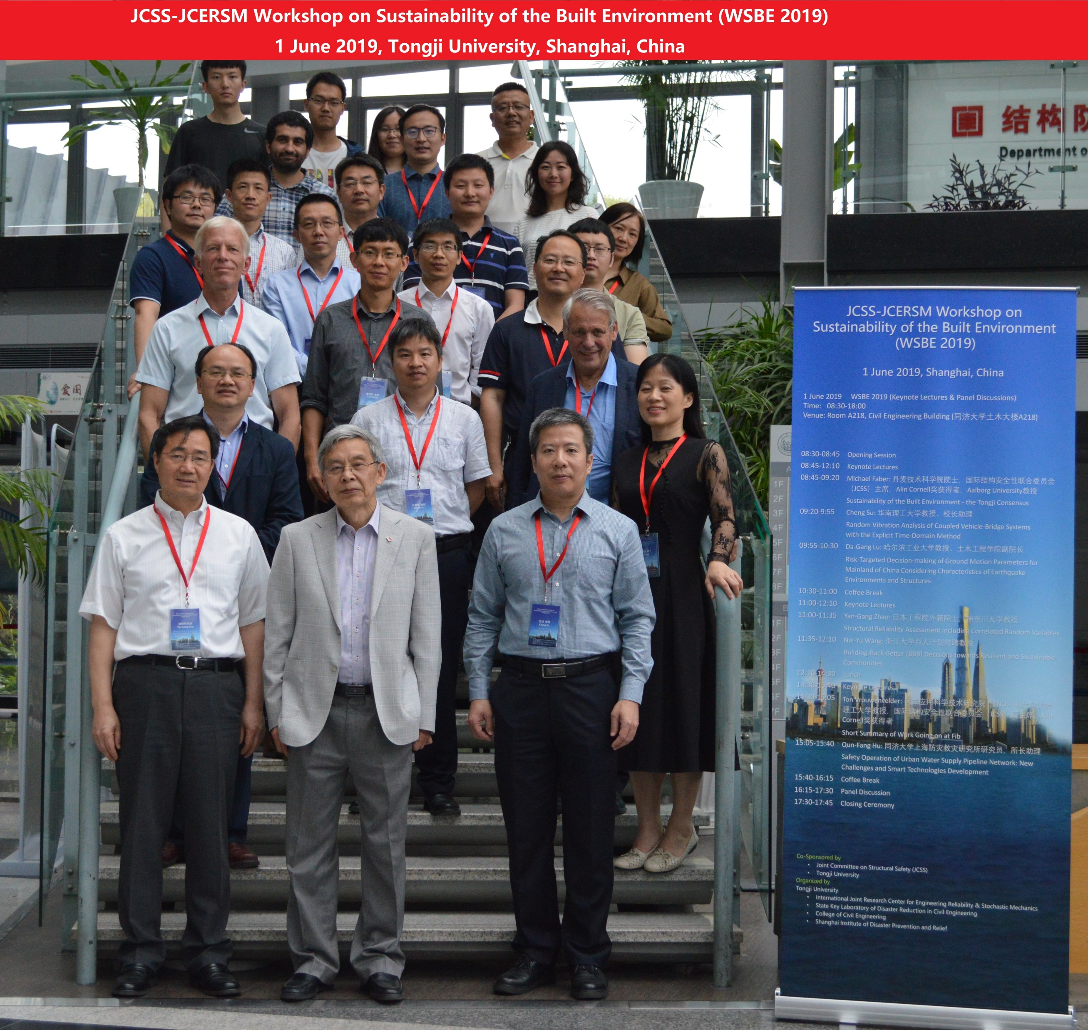
Global Consensus on Sustainability in the Built Environment
Initiation & way forward
IABSE – International Association for Bridge and Structural Engineering
fib – The International Federation for Structural Concrete
RILEM - International Union of Laboratories and Experts in Construction Materials, Systems and Structures
CIB – International Council for Research and Innovation in Building and Construction
ECCS – European Convention for Constructional Steel Work
IASS - International Association for Shell and Spatial Structures
JCSS – Joint Committee on Structural Safety
23 January 2021
Virtual Conference
9:10 to 17:45
Materials and value chains for sustainable, inclusive, and resilient urbanisation in Africa

Slide 10
Global Consensus on Sustainability in the Built Environment
Expert Task Force
major associations and networks in the areas of
research, education, development of building codes and recommendations
RILEM, IABSE, fib, CIB, ECCS, IASS Joint Committee for Structural Safety JCSS
23 January 2021
Virtual Conference
9:10 to 17:45
Materials and value chains for sustainable, inclusive, and resilient urbanisation in Africa

Slide 11
The “GLOBE consensus”
Challenges and ways out?
23 January 2021
Virtual Conference
9:10 to 17:45
Materials and value chains for sustainable, inclusive, and resilient urbanisation in Africa

Slide 12
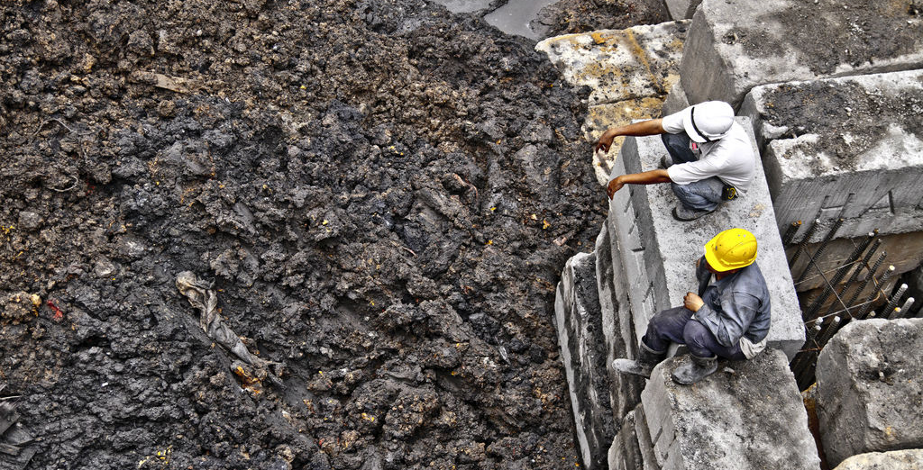
Global Consensus on Sustainability in the Built Environment
Challenges and ways out?
Dangerous, Dirty, Difficult
3D
23 January 2021
Virtual Conference
9:10 to 17:45
Materials and value chains for sustainable, inclusive, and resilient urbanisation in Africa

Slide 13
Global Consensus on Sustainability in the Built Environment
Challenges and ways out?
A vast number of companies, organizations, professions and stakeholders are involved in construction of buildings and infrastructure. An enormous effort is required to get adoption of applied technology enhancements in international standards, codes, and guidelines that govern the design and construction of the built environment We have to stand united and march together to achieve the objective of realising a sustainable construction sector
23 January 2021
Virtual Conference
9:10 to 17:45
Materials and value chains for sustainable, inclusive, and resilient urbanisation in Africa

Slide 14
The “GLOBE consensus”
Want to know more?
visit: globe.rilem.net
23 January 2021
Virtual Conference
9:10 to 17:45
Materials and value chains for sustainable, inclusive, and resilient urbanisation in Africa

Slide 15
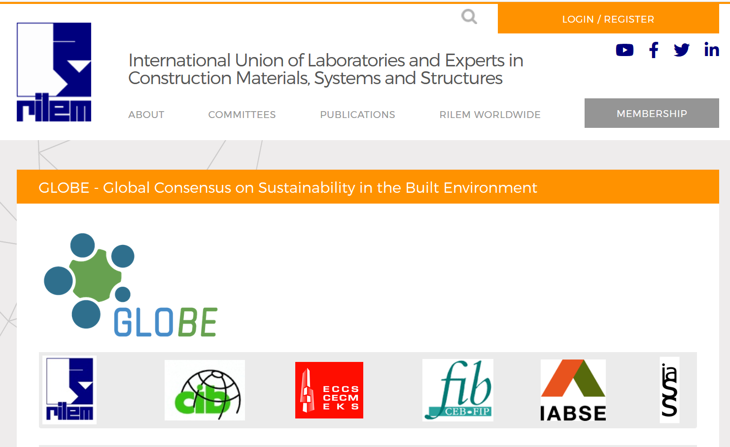
.rilem.net
23 January 2021
Virtual Conference
9:10 to 17:45
Materials and value chains for sustainable, inclusive, and resilient urbanisation in Africa

Slide 16
Consenso global para la sostenibilidad del entorno construido Spanish
建成环境可持续性全球共识
Chinese
Globaler Konsens zur Nachhaltigkeit im Bauwesen
German
Makubaliano ya Kimataifa juu ya Uendelevu katika Mazingira Yaliyojengwa
Kiswahili
Consenso Global sobre Sustentabilidade no Ambiente Construído
Portuguese
Глобальное соглашение по устойчивомуразвитию застроенной окружающей среды
Russian

Slide 17
The “GLOBE consensus”
Next steps
23 January 2021
Virtual Conference
9:10 to 17:45
Materials and value chains for sustainable, inclusive, and resilient urbanisation in Africa

Slide 18
Global Consensus on Sustainability in the Built Environment
Next steps
Background documents for experts
Guidelines for the engineering community
Position papers for the engineering associations of the construction sector
Recommendations for politicians, public authorities and regulatory bodies.
23 January 2021
Virtual Conference
9:10 to 17:45
Materials and value chains for sustainable, inclusive, and resilient urbanisation in Africa
Notes:
Major revisions take place only at intervals of about 20 years or more, represent compromises among stakeholders, and typically fail to use the best available knowledge for ensuring safety, resilience, and sustainability.

